Slide 1

Change Coordinate

Slide 2
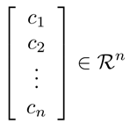
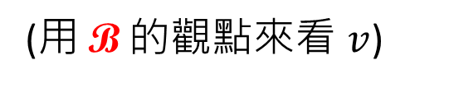
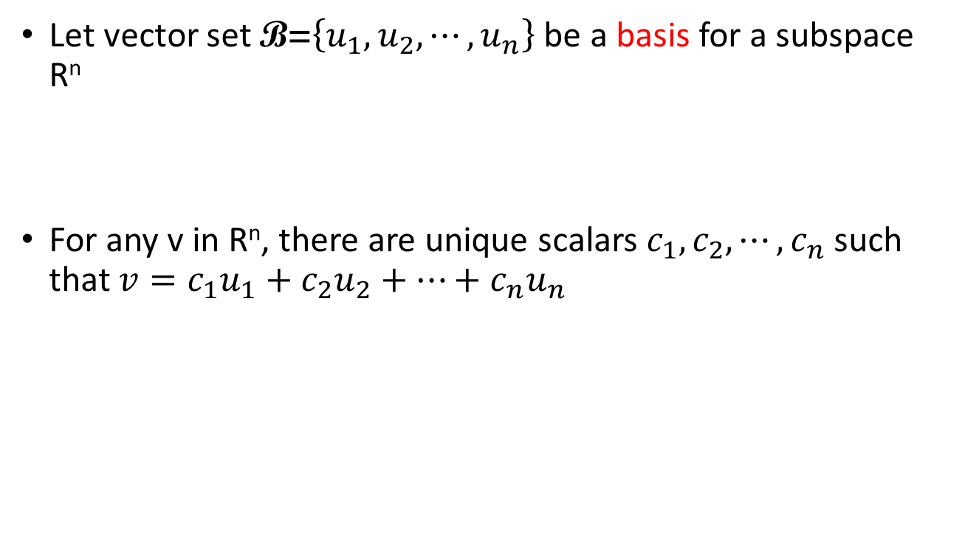

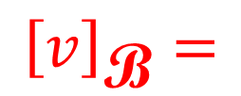
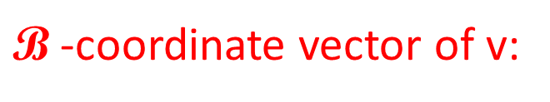
Coordinate System
Let vector set $\text{B}\text{=}\left\{u_{1},u_{2},⋯,u_{n}\right\}$ be a basis for a subspace R^{n}
For any v in R^{n}, there are unique scalars $c_{1},c_{2},⋯,c_{n}$ such that $v=c_{1}u_{1}+c_{2}u_{2}+⋯+c_{n}u_{n}$
$\text{B}$ is a coordinate system
$\text{B}$-coordinate vector of v:
$${\left[v\right]}_{\text{B}}=$$
(用 $\text{B}$ 的觀點來看 $v$)
Notes:
$$\text{(}\text{某種觀點}\text{)}$$
根據某種觀點所看到的結果

Slide 3
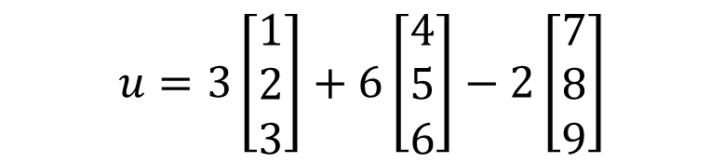
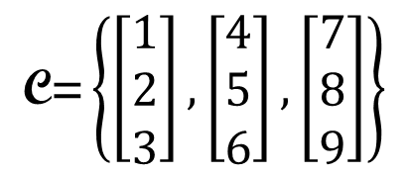
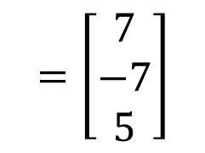
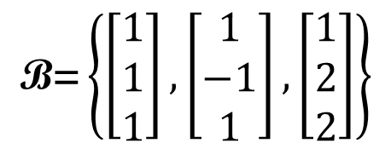
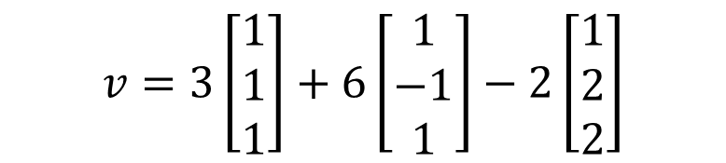
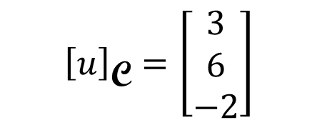
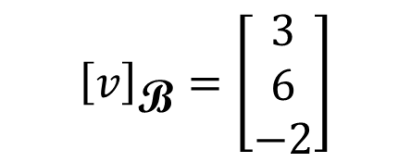
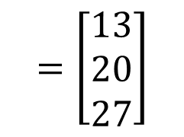
Other System → Cartesian
$$\text{B}\text{=}\left\{\left[\begin{aligned}1 \\ 1 \\ 1\end{aligned}\right],\left[\begin{aligned}1 \\ −1 \\ 1\end{aligned}\right],\left[\begin{aligned}1 \\ 2 \\ 2\end{aligned}\right]\right\}$$
$${\left[v\right]}_{\text{B}}=\left[\begin{aligned}3 \\ 6 \\ −2\end{aligned}\right]$$
$$=\left[\begin{aligned}7 \\ −7 \\ 5\end{aligned}\right]$$
$$v=3\left[\begin{aligned}1 \\ 1 \\ 1\end{aligned}\right]+6\left[\begin{aligned}1 \\ −1 \\ 1\end{aligned}\right]−2\left[\begin{aligned}1 \\ 2 \\ 2\end{aligned}\right]$$
$$\text{C}\text{=}\left\{\left[\begin{aligned}1 \\ 2 \\ 3\end{aligned}\right],\left[\begin{aligned}4 \\ 5 \\ 6\end{aligned}\right],\left[\begin{aligned}7 \\ 8 \\ 9\end{aligned}\right]\right\}$$
$${\left[u\right]}_{\text{C}}=\left[\begin{aligned}3 \\ 6 \\ −2\end{aligned}\right]$$
$$=\left[\begin{aligned}13 \\ 20 \\ 27\end{aligned}\right]$$
$$u=3\left[\begin{aligned}1 \\ 2 \\ 3\end{aligned}\right]+6\left[\begin{aligned}4 \\ 5 \\ 6\end{aligned}\right]−2\left[\begin{aligned}7 \\ 8 \\ 9\end{aligned}\right]$$

Slide 4
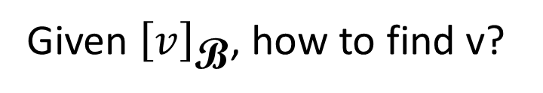
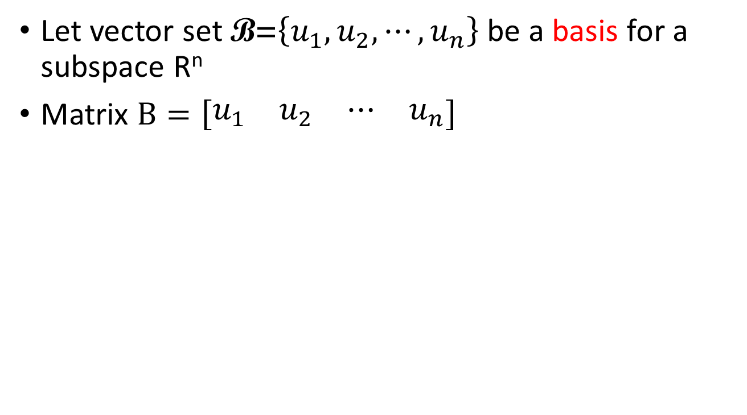
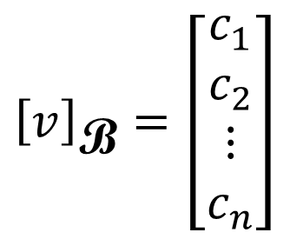
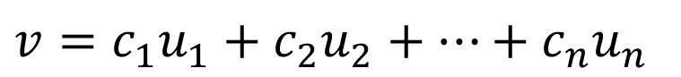
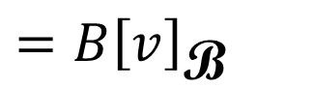
Other System → Cartesian
Let vector set $\text{B}\text{=}\left\{u_{1},u_{2},⋯,u_{n}\right\}$ be a basis for a subspace R^{n}
Matrix $B=\left[\begin{matrix}\begin{matrix}u_{1} & u_{2}\end{matrix} & \begin{matrix}⋯ & u_{n}\end{matrix}\end{matrix}\right]$
$${\left[v\right]}_{\text{B}}=\left[\begin{aligned}c_{1} \\ c_{2} \\ ⋮ \\ c_{n}\end{aligned}\right]$$
Given ${\left[v\right]}_{\text{B}}$, how to find v?
$$v=c_{1}u_{1}+c_{2}u_{2}+⋯+c_{n}u_{n}$$
$=B{\left[v\right]}_{\text{B}}$
(matrix-vector product)

Slide 5
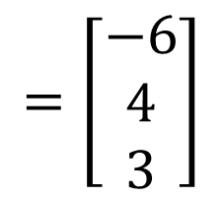
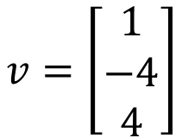
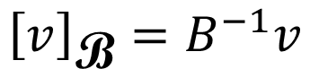
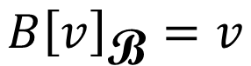
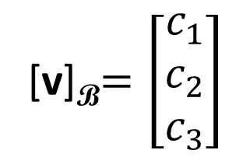
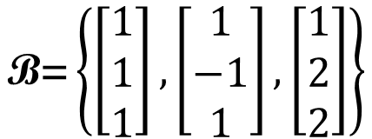
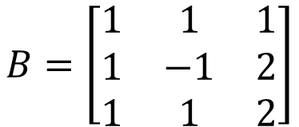
Cartesian → Other System
$$v=\left[\begin{aligned}1 \\ −4 \\ 4\end{aligned}\right]$$
$$\text{B}\text{=}\left\{\left[\begin{aligned}1 \\ 1 \\ 1\end{aligned}\right],\left[\begin{aligned}1 \\ −1 \\ 1\end{aligned}\right],\left[\begin{aligned}1 \\ 2 \\ 2\end{aligned}\right]\right\}$$
find [v]_{B}
[v]_{B}$=\left[\begin{aligned}c_{1} \\ c_{2} \\ c_{3}\end{aligned}\right]$
$$B=\left[\begin{matrix}1 & 1 & 1 \\ 1 & −1 & 2 \\ 1 & 1 & 2\end{matrix}\right]$$
B is invertible (?)
independent
$$=\left[\begin{aligned}−6 \\ 4 \\ 3\end{aligned}\right]$$
$$B{\left[v\right]}_{\text{B}}=v$$
$${\left[v\right]}_{\text{B}}=B^{−1}v$$

Slide 6
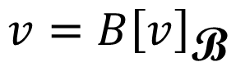
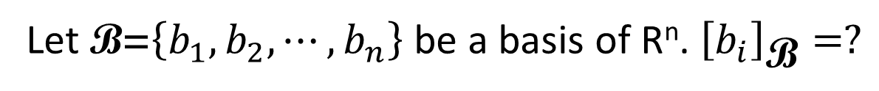
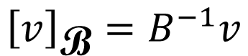

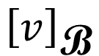
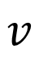
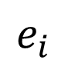
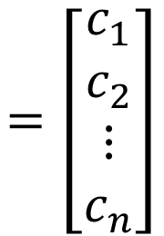
Cartesian $↔$ Other System
Let B = {b₁ , b₂ , 😐, b_{n}}
$${\left[v\right]}_{\text{B}}=B^{−1}v$$
$$v$$
$${\left[v\right]}_{\text{B}}$$
$$=\left[\begin{aligned}c_{1} \\ c_{2} \\ ⋮ \\ c_{n}\end{aligned}\right]$$
$$v=B{\left[v\right]}_{\text{B}}$$
= c₁b₁ + c₂b₂ + ☹ + c_{n}b_{n}
Let $\text{B}\text{=}\left\{b_{1},b_{2},⋯,b_{n}\right\}$ be a basis of R^{n}. ${\left[b_{i}\right]}_{\text{B}}=?$
$$e_{i}$$
(Standard vector)

Slide 7
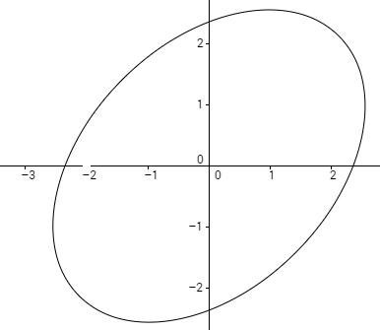
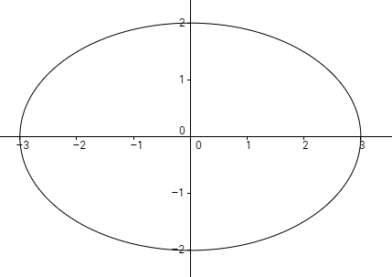
Equation of ellipse
Rotate 45◦
2
2
3
3
?
Notes:
Draw by
http://web.geogebra.org/app/

Slide 8
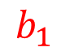
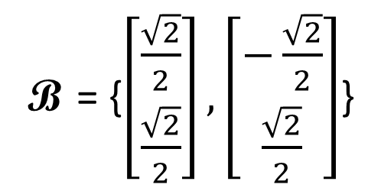
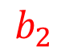
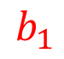
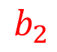
Equation of ellipse
Use another coordinate system
$$b_{1}$$
$$b_{2}$$
B = {$\left[\begin{aligned}\frac{\sqrt{2}}{2} \\ \frac{\sqrt{2}}{2}\end{aligned}\right],\left[\begin{aligned}−\frac{\sqrt{2}}{2} \\ \frac{\sqrt{2}}{2}\end{aligned}\right]$}
2
3
$$b_{2}$$
$$b_{1}$$
What is the equation of the ellipse in the new coordinate system?
Notes:
is

Slide 9
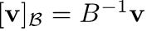
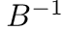
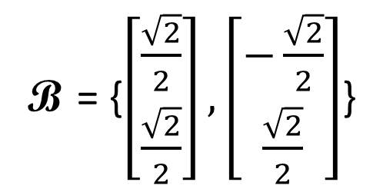
Equation of ellipse
B = {$\left[\begin{aligned}\frac{\sqrt{2}}{2} \\ \frac{\sqrt{2}}{2}\end{aligned}\right],\left[\begin{aligned}−\frac{\sqrt{2}}{2} \\ \frac{\sqrt{2}}{2}\end{aligned}\right]$}

Slide 10
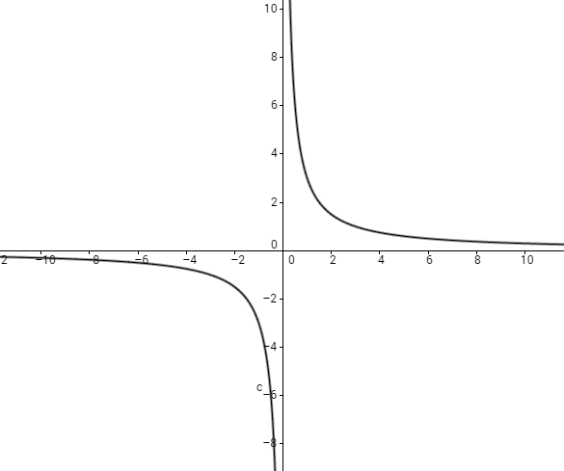
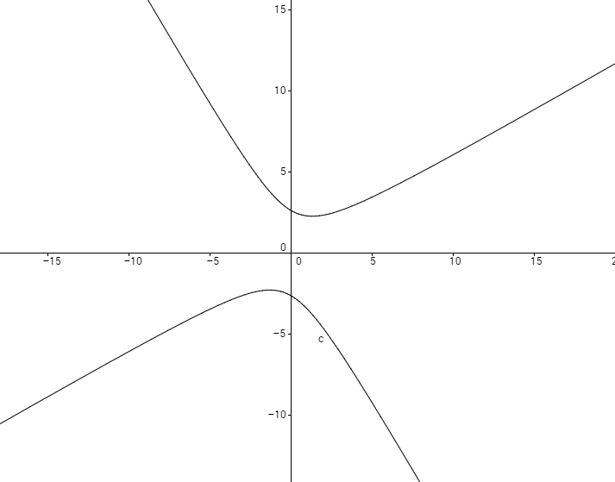
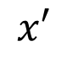
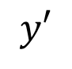
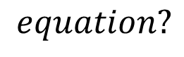
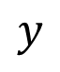
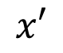
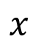


Equation of hyperbola
$$y′$$
$$y′$$
$$y$$
$$x′$$
30◦
$$x$$
$$x′$$
$$−\sqrt{3}x^{2}+2xy+\sqrt{3}y^{2}=12$$
$$equation?$$

Slide 11









Equation of hyperbola
$$B=\left[\begin{matrix}b_{1} & b_{2}\end{matrix}\right]$$
$$y′$$
$$b_{1}=\left[\begin{aligned}\frac{\sqrt{3}}{2} \\ \frac{1}{2}\end{aligned}\right]$$
$$b_{2}=\left[\begin{aligned}−\frac{1}{2} \\ \frac{\sqrt{3}}{2}\end{aligned}\right]$$
$$y$$
$$x′$$
30◦
$$b_{2}$$
$$b_{1}$$
$$v=\left[\begin{aligned}x \\ y\end{aligned}\right]$$
$${\left[v\right]}_{\text{B}}=\left[\begin{aligned}x′ \\ y′\end{aligned}\right]$$
$$v={B\left[v\right]}_{\text{B}}$$
$$x$$
$$\left[\begin{aligned}x \\ y\end{aligned}\right]=\left[\begin{matrix}\frac{\sqrt{3}}{2} & −\frac{1}{2} \\ \frac{1}{2} & \frac{\sqrt{3}}{2}\end{matrix}\right]\left[\begin{aligned}x′ \\ y′\end{aligned}\right]$$
$$−\sqrt{3}x^{2}+2xy+\sqrt{3}y^{2}=12$$

Slide 12





Equation of hyperbola
$$B=\left[\begin{matrix}b_{1} & b_{2}\end{matrix}\right]$$
$$−\sqrt{3}x^{2}+2xy+\sqrt{3}y^{2}=12$$
$$b_{1}=\left[\begin{aligned}\frac{\sqrt{3}}{2} \\ \frac{1}{2}\end{aligned}\right]$$
$$b_{2}=\left[\begin{aligned}−\frac{1}{2} \\ \frac{\sqrt{3}}{2}\end{aligned}\right]$$
$$x=\frac{\sqrt{3}}{2}x^{′}−\frac{1}{2}y^{′}$$
$$y=\frac{1}{2}x^{′}+\frac{\sqrt{3}}{2}y^{′}$$
$$v=\left[\begin{aligned}x \\ y\end{aligned}\right]$$
$${\left[v\right]}_{\text{B}}=\left[\begin{aligned}x′ \\ y′\end{aligned}\right]$$
$$v={B\left[v\right]}_{\text{B}}$$
$$x^{′}y^{′}=3$$
$$\left[\begin{aligned}x \\ y\end{aligned}\right]=\left[\begin{matrix}\frac{\sqrt{3}}{2} & −\frac{1}{2} \\ \frac{1}{2} & \frac{\sqrt{3}}{2}\end{matrix}\right]\left[\begin{aligned}x′ \\ y′\end{aligned}\right]$$

